Slide 1

SAYALI KUMAR

Slide 2
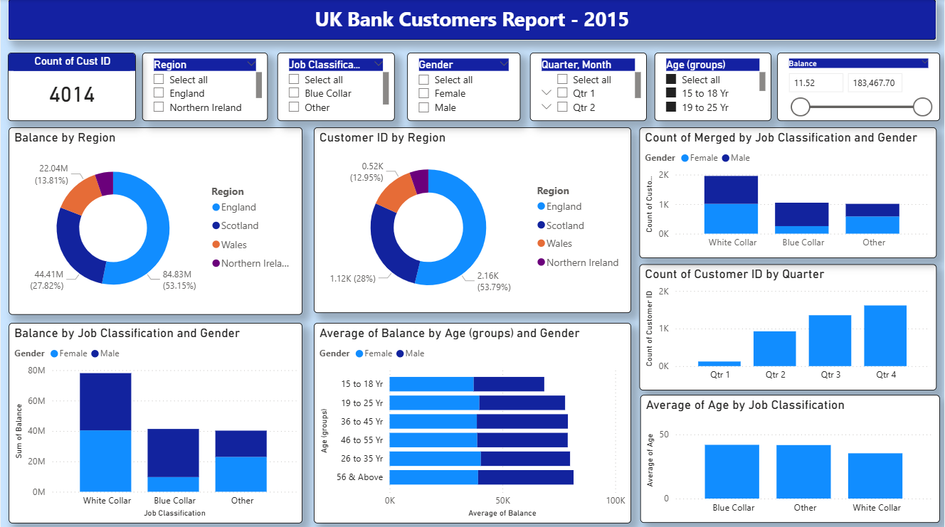

Slide 3
This dashboard is titled "UK Bank Customers Report - 2015" and it provides a comprehensive overview of banking customers in the UK, segmented by demographics and financial attributes. Here’s a structured description:
🎯 Overall Purpose
This dashboard is designed to help banks understand:
Customer segmentation by region, age, gender, and job type.
Financial behavior across demographics.
Trends over time, such as quarterly growth.
It’s essentially a customer profiling and financial analysis tool, useful for identifying high-value segments and tailoring banking strategies.

